Slide 1

VUE - CHAPTER 5
MUTIPLE PAGE
ROUTING

Slide 2
IMPORT COMPONENTS : GLOBALY OR LOCALY !
Global import
Local import
main.js
myComponent.vue
import BaseCard
from './components/UI/BaseCard.vue';
app.component('base-card', BaseCard );
<script>
import BaseCard
from './components/UI/BaseCard.vue';
export default {
components: { BaseCard }
Every component
Can use base-card
Only myComponent
Can use base-card

Slide 3
WHY
THIS
CLASS ?

Slide 4


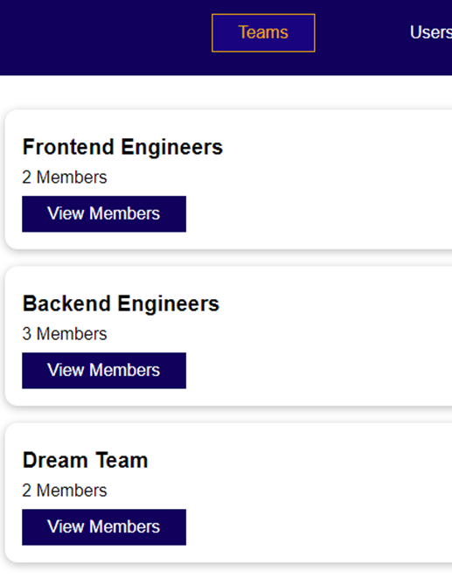
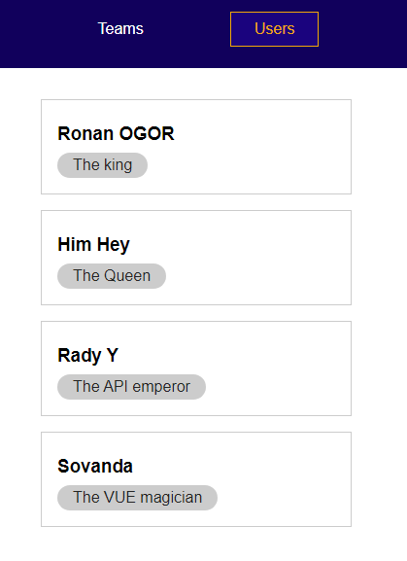
ACTIVITY 1
10 MIN
Open and execute the project
Understand how the MENU work
Does the URL change when you change the view ?
On click : show only the team-list component
On click : show only the user-list component

Slide 5

Because we build a SPA, the URL never changes :
It s always the
Index.html
But we this approach:
- We can just share the default page URL
- We cannot share the URL of a specific page

Slide 6
But we can manage specific URL using the VUE ROUTER !
<users-view>
<base url> / users
<base url> / teams
<team-view>
<base url> / contact
<contact-page>

Slide 7
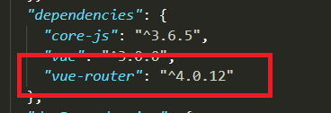
Configuration of router
#1
Install the VUE ROUTER using NPM
npm install vue-router@next
#2
You should the router on package.json

Slide 8
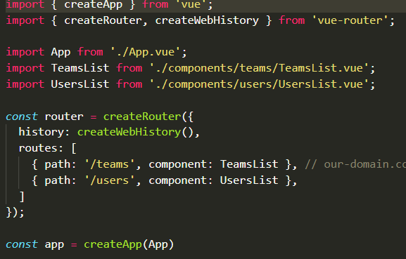
DEMO 1
router and <router –view> !

Slide 9

ROUTERS: HOW DO IT WORKS ?
1 – Setup the router on main.ts
const router = createRouter({
history: createWebHistory(),
routes: [
{ path: '/teams', component: TeamsList },
{ path: '/users', component: UsersList },
]
});
Link URL paths
To
Components
2 – Anywhere you need, use the <router-view> component to render the current routed component
<template>
<router-view></router-view>
</template>
You don’t need to register the component related to the routing any more!

Slide 10
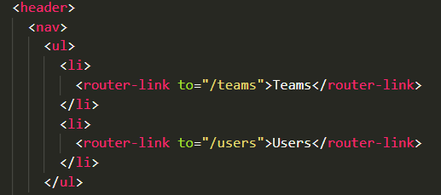
DEMO 2
navigation using <routing-link>

Slide 11
HOW DOES ROUTER-LINK WORKS ?
Router-link are like <a> elements, linking to a path of the ROUTER :
<router-link to="/teams">Teams</router-link>
On click
<router-view></router-view>
The router-view is now on the teamList component

Slide 12
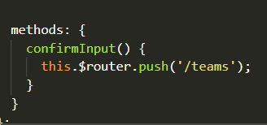
DEMO 4
Navigation programmatically

Slide 13
HOW DOES ROUTER PUSH WORKS ?
You also can programmatically change the active route:
methods: {
confirmInput() {
this.$router.push('/teams');
}
}
<router-view></router-view>
The router-view is now on the teamList component

Slide 14
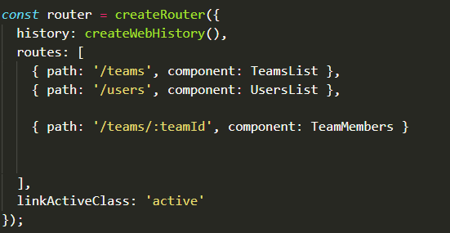
DEMO 5
Path with parameters

Slide 15
HOW DOES ROUTE WITH PAMETERS WORKS ?
1- Define the route with some parameters :
{ path: '/teams/:teamId', component: TeamMembers }
2- The parameter can be retrieved using the $route parameters:
const teamId = this.$route.params.teamId;
3- You can also get your teamID as a prop :
{ path: '/teams/:teamId', component: TeamMembers, props :true }

Slide 16
ACTIVITY 2
10 MIN
When we click on the View member, we want to route to /teams/:teamID
To see the list of members of the team related to the team ID
Try to do this using the router link component :
<router-link to:”/yourPath” >
On click

Slide 17
ROUTERS: A LOT MORE !!!!
Route to a not found
component
routes: [
{ path: '/:notFound(.*)', component: NotFound }
{ path: '/', redirect: '/teams' },
{
name: 'teams',
path: '/teams',
meta: { needsAuth: true },
components: { default: TeamsList, footer: TeamsFooter },
beforeEnter(to, from, next) {
console.log('users beforeEnter');
console.log(to, from);
next();
}
}
Redirect the path
Require authentication for this path
Provide a footer
Do something before entering to
The component

